Slide 1
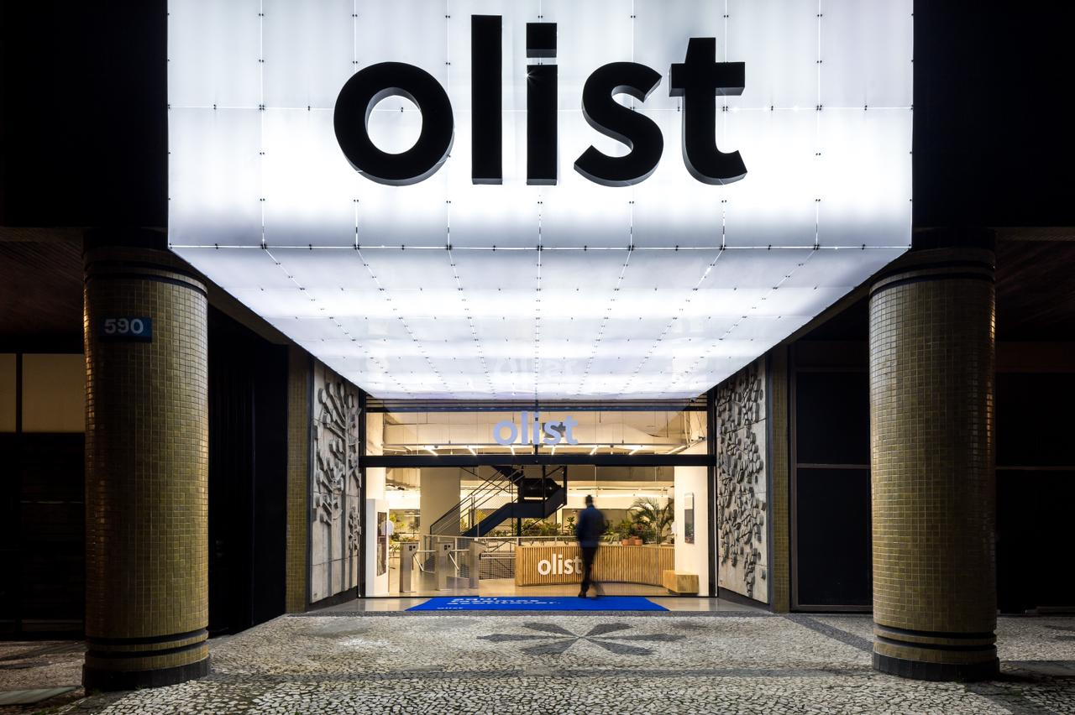
E-COMMERCE ANALYSIS

Slide 2
INDEX
INTRODUCTION
OBJECTIVE
DATA PROCESSING
CHALLENGES
TOOLS USED
KPI’S
DASHBOARDS
INSIGHTS DERIVED
FUTURE RECOMMENDATIONS

Slide 3
INTRODUCTION
The OLIST STORE is an e-commerce business headquartered in Sao Paulo, Brazil. This firm acts as a single point of contact between various small businesses and the customers who wish to buy their products. In this project we were given multiple tables in CSV format and a schema depicting how these tables are connected. After connecting all the 8 tables, we analyzed the entire dataset. It contains multiple categorical and numerical columns and information about 100k orders made at multiple marketplaces between 2016 to 2018.

Slide 4
OBJECTIVE
Dashboard to Discuss current year and previous year business numbers with E-Commerce Store.
That Dashboard will be discussed between corporate team and individual branch heads.
Discuss performance metrics in the branch.
Overall Performance Summary.
Key Insights and Action items.
Summary of Current Year and previous year business numbers for the country of Brazil

Slide 5

Processing ( Data Exploration and Data Cleaning)
Null and Empty Columns
Irrelevant Columns
To clean them, we replaced them with the correct data using excel “Find and replace” functions.
validated them completely after taking all the necessary precautions.
Data Types
Duplicates
Erased every duplicate the help of the excel Filter function.
They were converted using the Format cells menu in excel.

Slide 6
CHALLENGES FACED
KPI Definition Complexity:
Defining Key Performance Indicators that are both meaningful and easy to understand proved challenging.
Balancing simplicity for users with the need for actionable insights required careful consideration.
Interactive Dashboard Design:
Creating an interactive and user friendly dashboard posed challenges.
Striking the right balance between provided comprehensive information and keeping the dashboard easy to use demanded creativity and brainstorming.
Handling Large Data Sets:
Dealing with large amount of data sets proved to be extremely challenging.
Optimizing the project to handle large datasets required fine tuning and concentration.

Slide 7




Tools Used To Overcome Challenges
It serves as a cornerstone of our analytics toolkit because it facilitates data manipulation, cleaning and basic analysis providing us with a basic foundation for further exploration.
Tableau is a visual analytics platform that helps users manage, explore, and combine data from multiple sources to solve problems.
Excel
Tableau
Power BI
SQL
It helps us to create interactive dashboards and reports through which we can delve into our data and get actionable insights.
It is the backbone of our data infrastructure because it ensures seamless access and analysing of vast data sets.

Slide 8
KPI’S
KPI 1
KPI 2
Weekday vs weekend payment statistics
Total number of orders with Review Score 5 and Payment type as a credit card
KPI 3
Average number of days taken for order delivery for pet shop
KPI 4
KPI 5
Average price and payment values from customers of Sau Paulo city
Relationship between shipping days and review scores

Slide 9
Explanation Of Each KPI
Weekday VS weekend payment statistics :- analysing the difference in order, volume and payment values between weekdays and weekends to identify peak shopping times and customer spending patterns.
Total number of orders which review score 5 and payment type as a credit card :- monitoring the number of top rated orders paid by credit card to assess customer satisfaction and preferred payment methods.
Average number of days taken for order delivery for pet shop :- calculating the average delivery time for pet shop, orders to evaluate efficiency and identify areas for improvement.
Average price and payment values from customers of Sao Paulo city :- determining the average order price and payment values from Sao Paulo city customers to understand regional spending behaviour.
Relationship between shipping days and review scores :- investigating how the duration of shipping impacts customer reviews, aiming to improve delivery times and enhance customers satisfaction.

Slide 10
DASHBOARDS

Slide 11
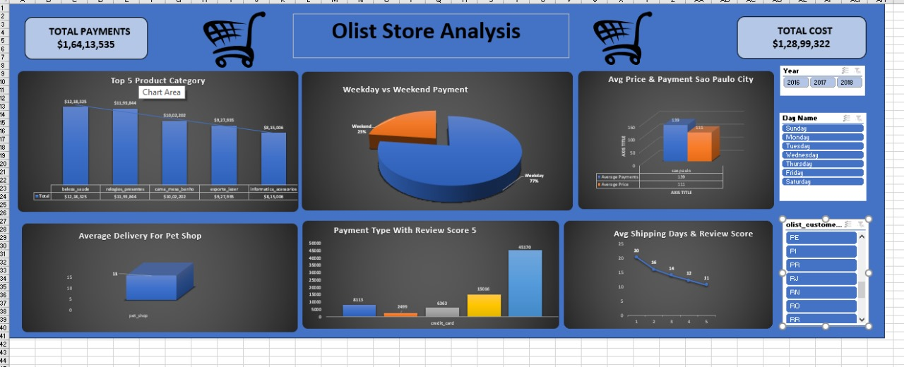
EXCEL

Slide 12
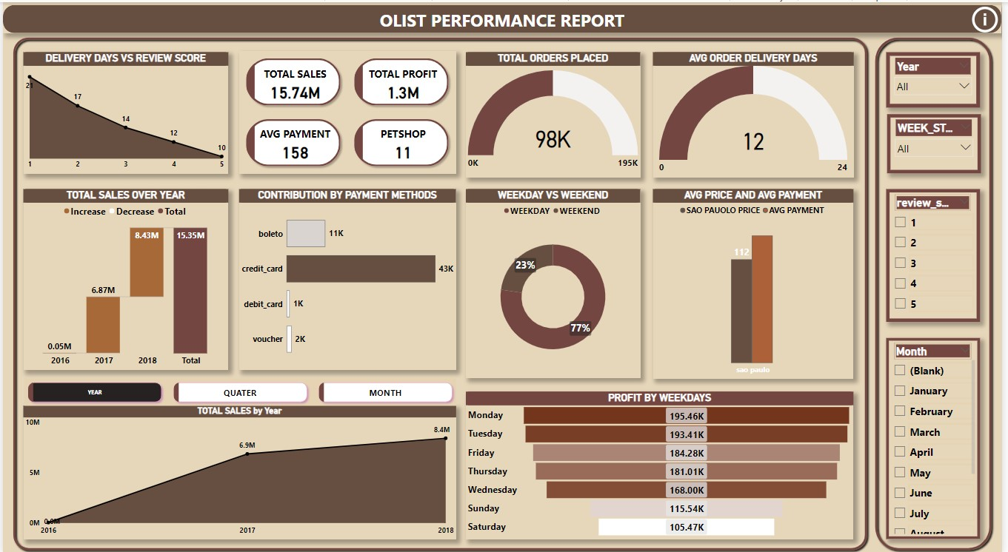
POWER BI

Slide 13
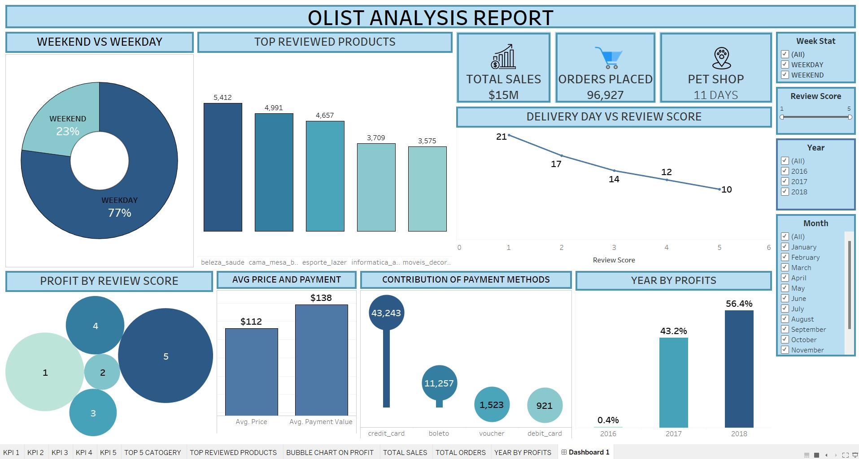
TABLEAU

Slide 14
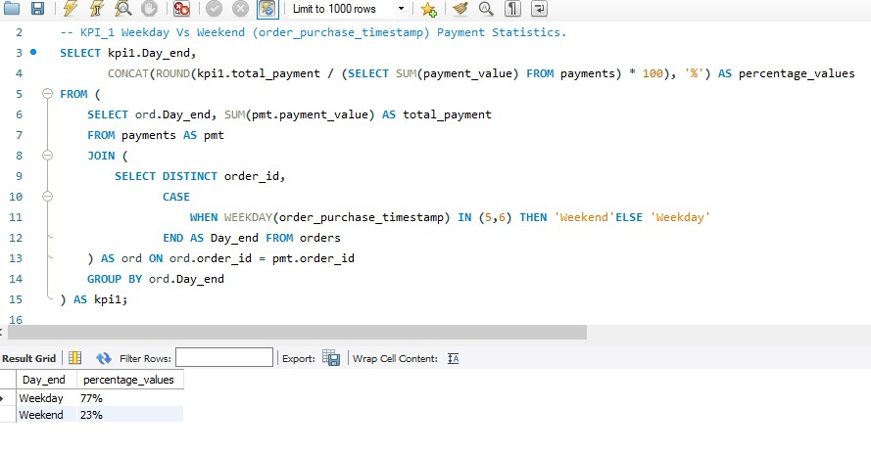
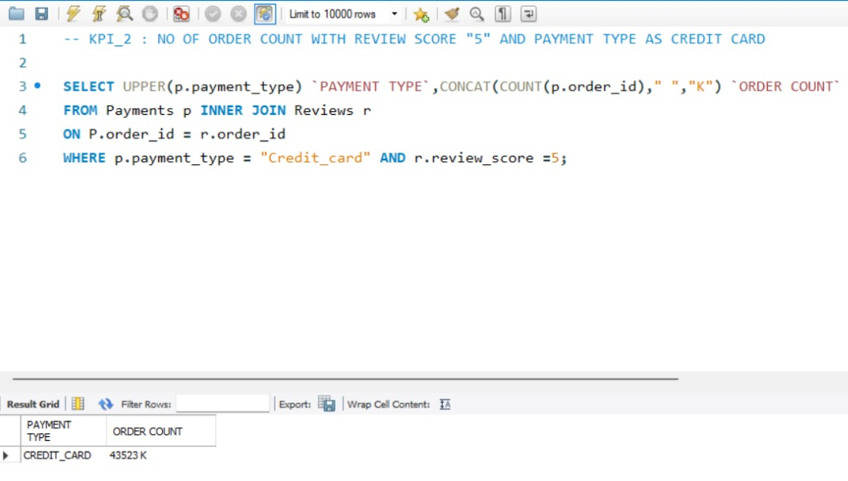
SQL Queries and their Derived results

Slide 15
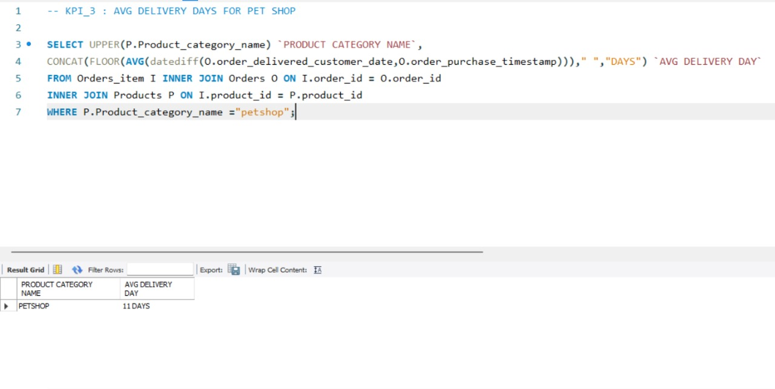
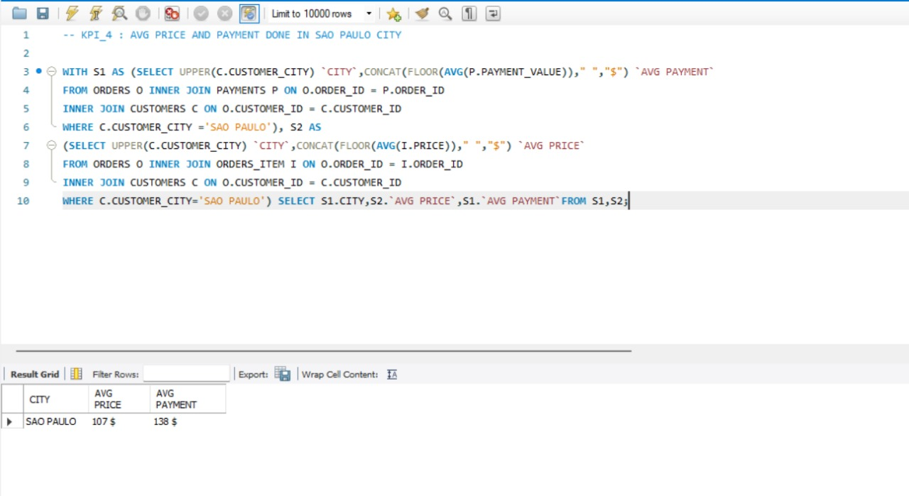

Slide 16
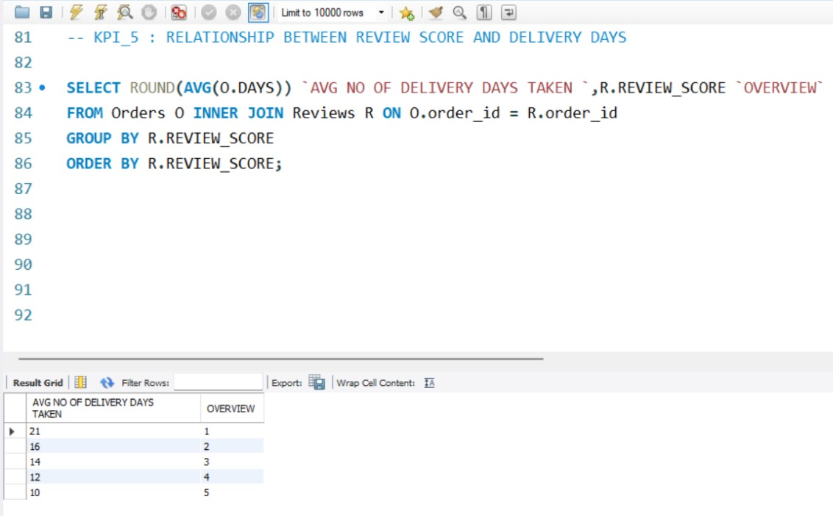

Slide 17
INSIGHTS DERIVED

Slide 18
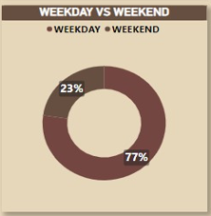
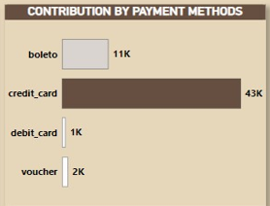
KPI 1: Weekday vs Weekend
Weekday payments (77%) significantly outweigh weekend payments (23%). Monday has the highest order volume, while Saturday has the lowest. There's a need to boost weekend orders. Order growth increased substantially from 2016 to 2017.
KPI 2: Payment methods
Credit card orders total 76,055, with 57.82% receiving a 5 star review. The highest number of 5 star reviews (43,981) contrasts sharply with the lowest 2 star reviews (2,407). There's a significant 33.37% gap between 4 and 5 star reviews. To improve lower ratings (1 to 3 stars), customer feedback should be carefully analyzed and addressed.

Slide 19

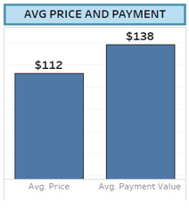
KPI 3: Pet shop deliveries
Pet shop orders take average 11 days for delivery, with peak orders from April to August. August saw improved delivery (8 days) and a 4.3 rating. Total payment value generated from pet shop items is $ 255,331.
KPI 4: Avg Price And Payment Per Cities
Sao Paulo City customers have higher average purchase prices ($112) and payment values ($138) compared to other locations. The city has a large, growing customer base and contributes significantly more to overall sales and payment values than other cities. Total price and payment values in Sao Paulo have increased substantially over time.

Slide 20
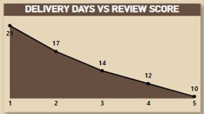
KPI 5: Shipping Days Vs Review Score
Average shipping takes 10 days with a 5 star review score. Shorter delivery times correlate with better reviews. Longer deliveries decrease scores and increase costs. Package weight and size affect delivery time.

Slide 21
ADDITIONAL INSIGHTS
Currently credit cards are the most preferred payment type by customers which contributes a major role in overall sales(77 %). To improve sales & to promote other payment types, O-list Store can provide discounts & offers on other payment types.
OLIST Store needs to work more during the last quarter to improve the sales as there are less orders placed during September to December months which also results in less average review score. Store needs to focus on advertisement & different offers on products during the period.
Maximum customer crowd is from Sao Paulo & Eastern side of the country as compared to other regions. To improve the sales in other regions stores need to focus on campaign & promotion in these regions.

Slide 22
After observing the comment section we got to know that Bed bath table, health beauty, sports leisure, furniture decor, computer accessories, housewares & watches gifts are the products which receive maximum of the recommendation from customers with average review score 4.08 which shows these are most demanding products among the customers.
From 5th KPI we can conclude that if sellers take longer days to deliver the product then customers provide less review score which shows it is one the factor that influences review score.
Sellers should improve on delivery days & should keep customers informed about status of delivery it will make time go much faster for customer and will create personalize experience because they know what's happening.

Slide 23
FURTHER RECOMMENDATIONS

Slide 24
RECOMMENDATIONS FOR FURTHER ANALYSIS
1. Investigate delivery delay and undelivered orders by analysing geographic locations could bring insights about certain challenges with demographics, accessibility, and possible route optimisation.
2. Tracking fleet performance.
3. Perform a detailed analysis of delivery locations to identify areas with frequent delays.
4. Optimise delivery routes using geographic information system (GIS) to reduce delivery time.
5. Ensure that all parties involved in the delivery process have access to the same information to reduce miscommunication .

Slide 25
THANK YOU

